Slide 1
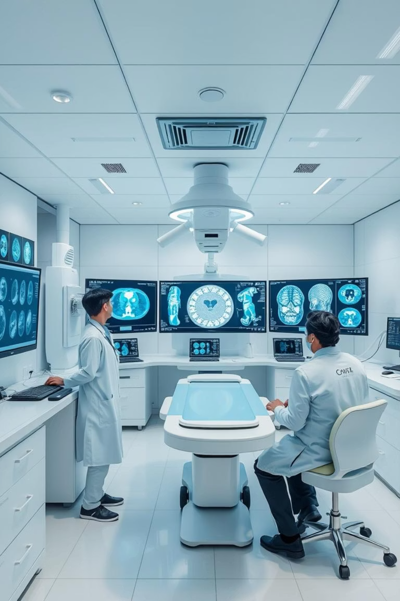
FPGA in Medical Imaging: Enhancing Diagnostics at the Edge

Slide 2
Agenda
1
Bridging the Gap: FPGA & Medical Tech
2
Deep Dive: Featured Research Papers
Overview of challenges and opportunities in medical embedded systems.
Analysis of cutting-edge FPGA applications in medical imaging and diagnostics.
3
Synergies: Common Threads & Innovations
4
Future Directions: Leveraging FPGA for Impact
Identifying key trends and shared advancements across projects.
Strategic insights and potential next steps for impactful research.

Slide 3

A Lightweight Deep CNN for Breast Cancer Detection
The Innovation
Why It Matters
Lightweight CNN: Designed for breast cancer detection using ultrasound.
Efficient & Portable: Ideal for low-resource settings, enabling decentralized diagnostics.
Dual Implementation: Deployed on FPGA and Android for real-time inference.
FPGA Optimization: Handles image preprocessing and acceleration, reducing latency and power.
Real-Time Edge Processing: Low power consumption for instant results on embedded devices.
High Accuracy: Achieves reliable detection with minimal hardware footprint.
Our Contribution: Advancements
Expand to detect other recurring diseases (e.g., lung, kidney pathologies).
Utilize advanced CNN compression (quantization, pruning) for enhanced optimization.
Integrate cloud support for continuous feedback and remote monitoring, boosting diagnostic capabilities.

Slide 4
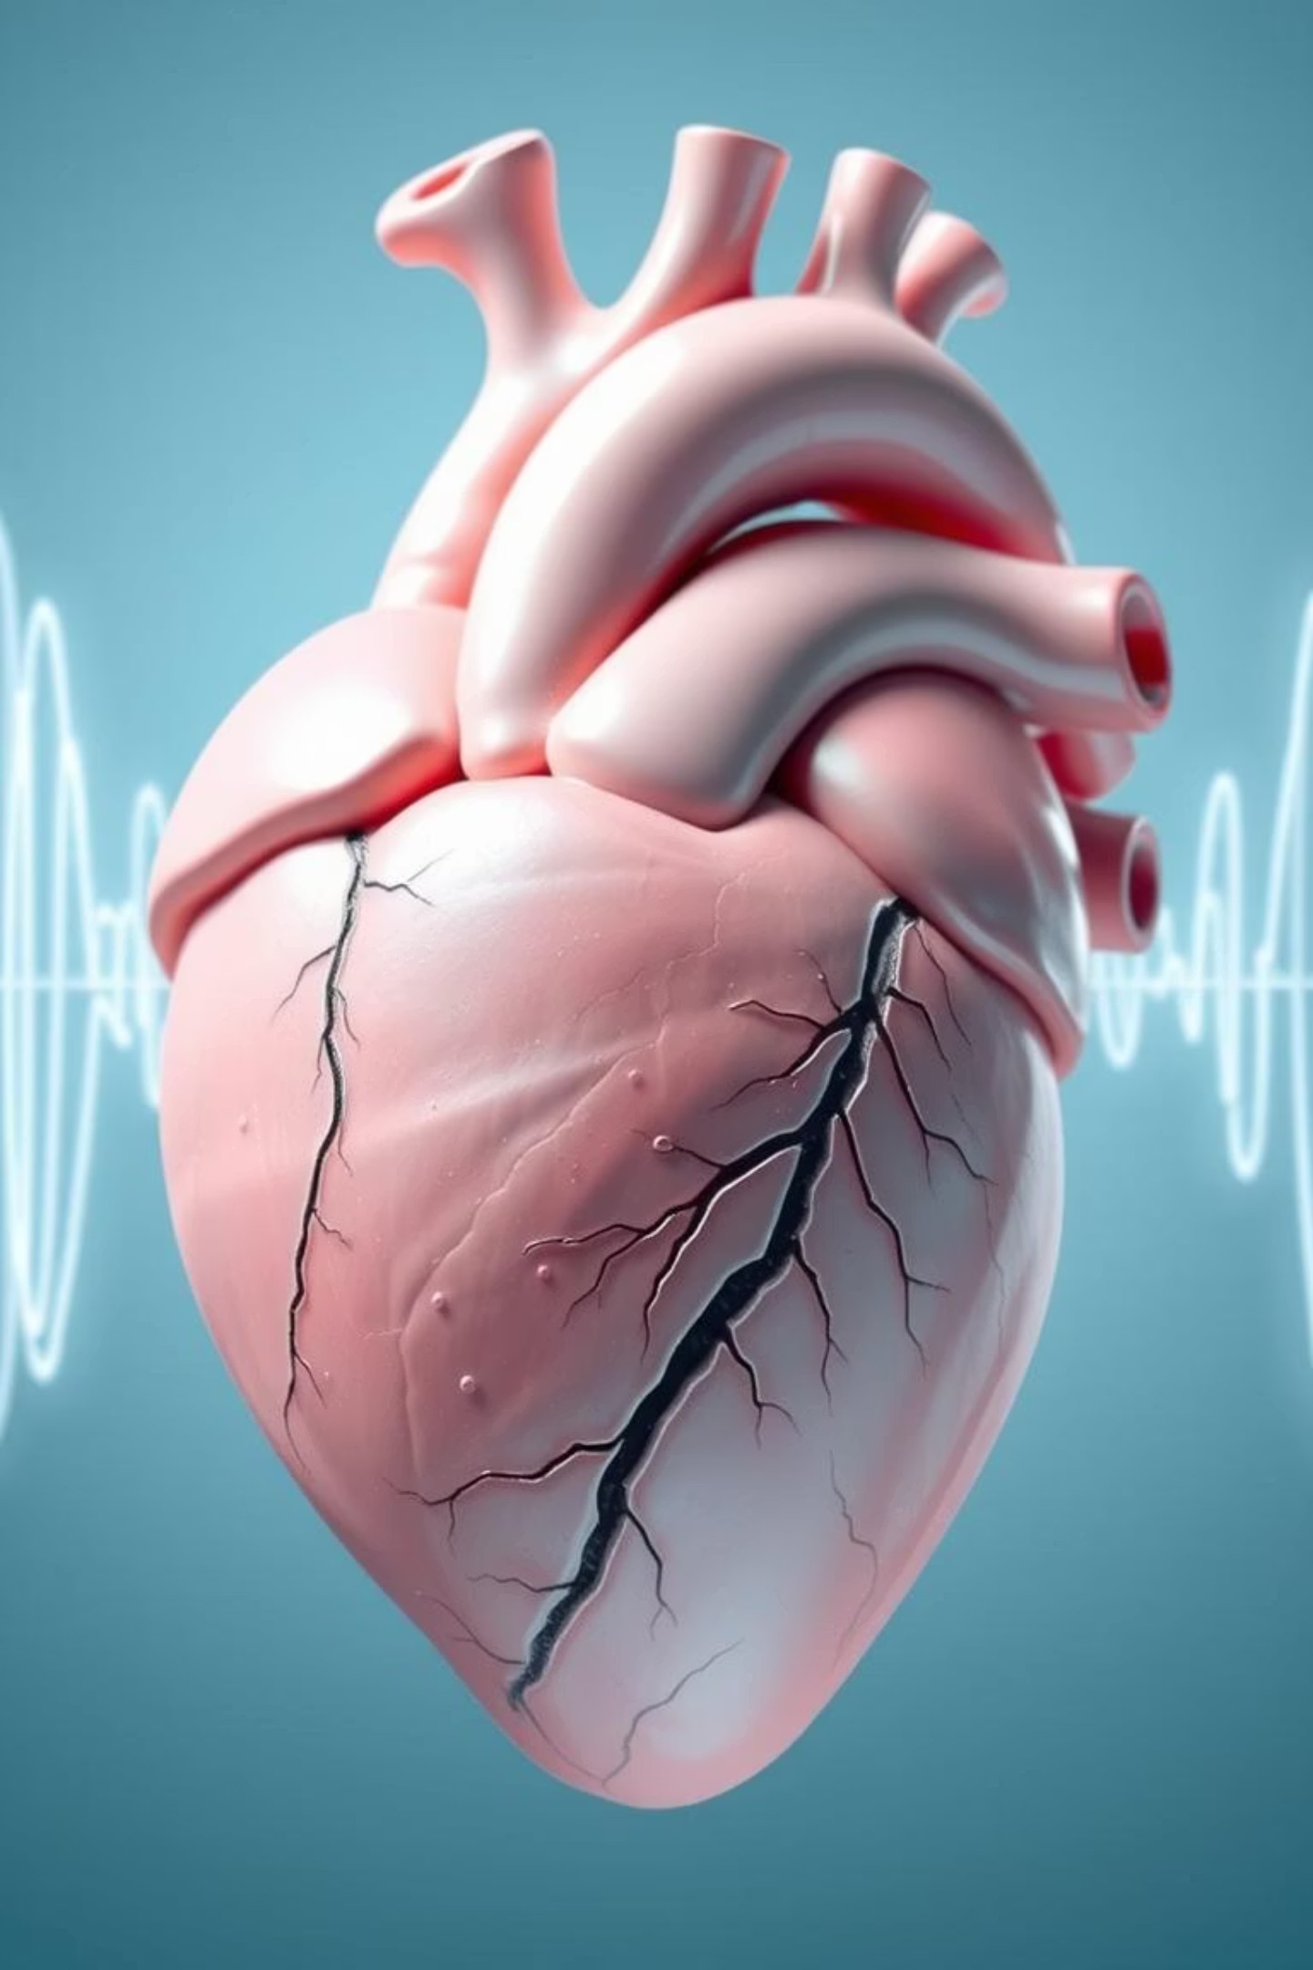
FPGA for Real-Time Heart Sound Segmentation
The Innovation
Why It Matters
Portable & Low-Cost: Focuses on heart sound segmentation from phonocardiogram (PCG) signals.
Point-of-Care Diagnostics: Provides an affordable, immediate solution for cardiovascular issues.
FPGA-Enabled Processing: Facilitates fast, real-time signal processing directly on the device.
Efficient & Accurate: FPGA ensures high-speed, precise signal analysis.
Mobile Health Ready: Perfectly suited for remote and underserved areas, bridging healthcare gaps.
Our Contribution: Advancements
Implement lightweight deep learning models for superior resource optimization on FPGA.
Explore adaptive filtering and AI-based anomaly detection to significantly improve diagnostic accuracy.
Extend platform for multi-organ imaging or diverse disease detection, increasing its utility.

Slide 5

FPGA Prototype for Parkinson's Detection via Voice
The Innovation
Why It Matters
Voice Signal Analysis: Detects Parkinson's disease using speech patterns.
Non-Invasive Early Detection: Offers a simple method for early diagnosis through speech.
Feature Extraction: Analyzes jitter, shimmer, and pitch frequency.
Portable & Low-Power: FPGA-based solution enables diagnosis anywhere, even at home.
Optimized Design: Achieves low-latency, energy-efficient, and portable diagnosis.
Accessibility: Expands diagnostic reach to rural communities, enhancing healthcare equity.
Our Contribution: Advancements
Integrate deep learning models (CNN, LSTM) for robust voice pattern recognition.
Extend detection to other neurodegenerative or speech disorders, broadening diagnostic scope.
Apply model optimization techniques (quantization, pruning) for improved FPGA resource efficiency.

Slide 6
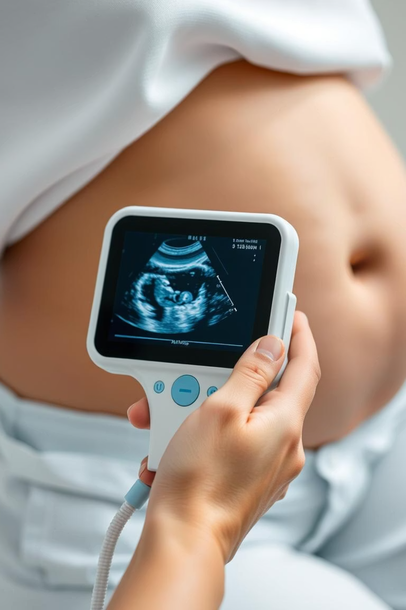
Portable Handheld Ultrasound with FPGA-Based SAI
The Innovation
Why It Matters
Handheld Ultrasound: Utilizes Synthetic Aperture Imaging (SAI) for portable scanning.
Remote Area Utility: Highly beneficial for regions with limited access to advanced medical equipment.
Integrated Processing: Employs DSP, Doppler, and B-SCAN methods for on-device image processing.
Cost-Effective: Low-cost FPGA implementation makes it accessible.
Single-Probe Operation: Simplifies use and streamlines the scanning process.
Simplified Design: Focuses on a user-friendly handheld device for basic ultrasound.
Our Contribution: Advancements
Leverage as an input device for advanced diagnostic systems requiring ultrasound data.
Enhance FPGA specs to enable both input and output processing on a single board, improving system integration.
Implement model optimization techniques (quantization, pruning) for superior FPGA resource efficiency.

Slide 7

FPGA SoC for Adaptive IoMT Edge Intelligence
This paper serves as an inspirational blueprint, showcasing the full potential of integrated systems.
The Innovation
Why It Matters
Adaptive DNNs: Developed for multimodal edge intelligence in healthcare.
Next-Gen Healthcare Tech: Combines AI, Edge Computing, IoMT, and FPGA.
FPGA-SoC Implementation: Ensures real-time, low-power edge computing for IoMT.
Adaptive & Resilient: Adjusts to constraints like battery life and network conditions.
Multimodal Data Fusion: Integrates audio, image, and text for robust decision-making.
Full Implementation: Demonstrates complete data fusion to classification.
Dynamic Network Selection: Adjusts model complexity based on input and hardware resources.
Real-World Impact: Applicable in wearables, smart hospitals, and rural health.

Slide 8






Advancing IoMT Edge Intelligence
This section builds upon the previous inspirational paper, focusing on actionable enhancements for future research and development.
Custom Hardware Accelerators
Extend the platform with specialized accelerators for complex operations like LSTM or transformer blocks, boosting processing speed for advanced AI models.
TinyML Integration
Further optimize models with TinyML principles, enabling deployment on even more constrained and low-power devices for broader accessibility.
Enhanced Security Modules
Incorporate robust security features (encryption, secure boot) to ensure deployability in commercial medical IoT networks, addressing critical privacy concerns.
Regional Dataset Training
Train the system on diverse regional datasets (e.g., Indian medical data) to improve local applicability and accuracy, tailoring solutions to specific population needs.

Slide 9
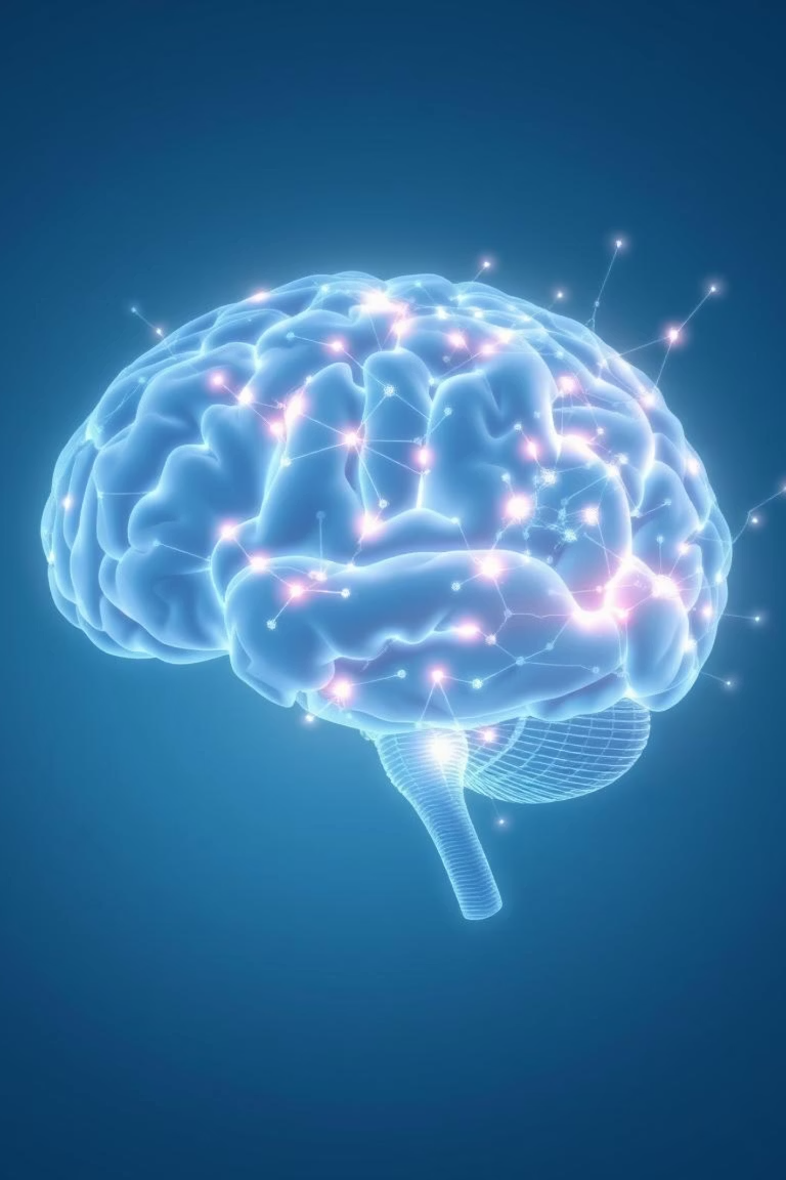
Key Takeaways & Future Outlook
Shared Insights
Path Forward
FPGA's Central Role: Significant developments in medical tech leverage FPGA for efficient embedded systems.
Enhanced DNNs/RNNs: Potential to further boost accuracy in existing applications.
Target Real-Time Problems: Focus on medical issues that still lack efficient, FPGA-ML/DL-driven solutions.
ML/DL Synergy: Almost every project integrates machine learning or deep learning for optimized hardware utilization.
New Domain Exploration: Apply this approach to other fields beyond current studies, driven by real-world needs.
Hardware Acceleration: A consistent theme across papers, crucial for improving performance and efficiency.

Slide 10

Thank You

